Slide 1
EliminatioN disorders
By: Amr Ahmed Osman
Assistant lecturer of pediatric

Slide 2
normal sequence of developing control
over bowel and bladder functions is
nocturnal fecal continence… Diurnal fecal continece…diurnal bladder control….. Nocturnal bladder control

Slide 3

Toilet training is affected by
inellectual capacity
social maturity
cultural factor
psychologic interaction between child and parents

Slide 4
Two elimination disorders described in the DSM IV
Encopresis …….. After age 4 years
Enuresis ………….. After age 5 years

Slide 5
Encopresis

Slide 6


Slide 7
A- Repeated passage of feces into inappropriate places ( eg, clothing or floor) whether
involuntary or intentional.
B- At least one such event a month for at least 3 months.
C- at age at least 4 years
D - the behavior is not due to direct effect of a drug as laxatives

Slide 8
Etiology.
caused mostly by a complicated interplay between physiologic and psychologic factors.
75% of encopretic children show evidence of chronic constipation leading to infrequent defaecation, faecal impaction and eventual overflow soiling

Slide 9
chronic constipation mostly due to
painful defaecation
Traveling
in adequate diet
not drinking enough water

Slide 10

many psychiatric disturbances could be the cause of encopresis in children as
sexual abuse
birth of new sibling
move to new home
Hard punitive parenting
Autism , ADHD

Slide 11
Congenital Megacolon” Hurshsprung,
Psychogenic megacolon
iatrogenic post operative incompetence of anal sphincter

Slide 12

Psychogenic Megacolon
Anorectal dysfunction exit 2ry to the chronic constipation resulting from chronic rectal distetion from large hard fecal mass that cause loss of tone in the rectal wall and desensitization to pressure resulting in feces retention and then over flow

Slide 13
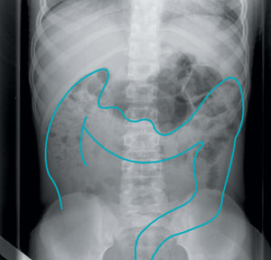
Diagnosis
careful history
Abdominal x ray to evaluate the amount of stool in the large intestine

Slide 14
Contrast enema
Manometric studies
EMG of anal sphincter

Slide 15
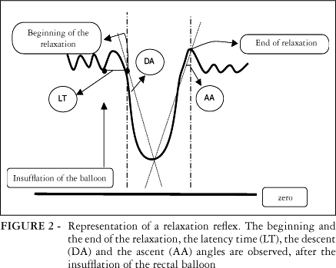
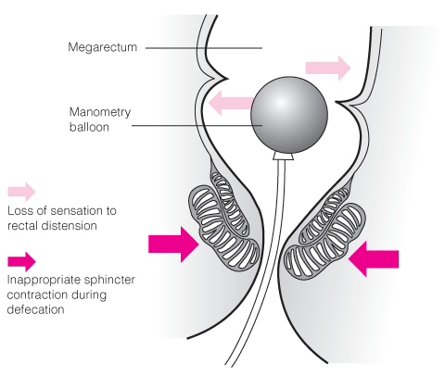
Manometric studies

Slide 16
Anorectal motility abnormalities in children with encopresis and chronic constipation.
Raghunath N¹, Glassman MS, Halata MS, Berezin SH, Stewart JM, Medow MS.
Author information
Abstract
OBJECTIVE:
To evaluate the response to rectal distension in children with chronic constipation and children with chronic constipation and encopresis.
STUDY DESIGN:
We studied 27 children, aged 3 to 16 years, with chronic constipation; 12 had encopresis. Anorectal motility was measured with a solid state catheter. When the catheter was located in the internal sphincter, the balloon was inflated to 60 mL with air.
RESULTS:
There were no differences in age, sex distribution, and duration of constipation in the two groups. Comparing groups, anorectal manometry showed no differences in the resting sphincter pressure, recovery pressure, the lowest relaxation pressure, and percent relaxation. However, time to maximum relaxation, time to recovery to baseline pressure, and duration of relaxation were significantly higher in patients with constipation and encopresis, compared with patients who had constipation alone.
CONCLUSIONS:
There may be an imbalance in neuromuscular control of defecation in constipated patients with encopresis that results in incontinence as a consequence of the increased time to recovery and duration of relaxation of the internal anal sphincter.

Slide 17

Bowel management programme
Cleaning of hard stool out of lower colon by enema , laxatives
encourage eating more fruits and vegetables with drinking enough amount of fluids

Slide 18
Toilet sitting at least twice a day
encourage exercise that help in digestion instead of TV watching

Slide 19
management of any asociated psychological problem
psychotherapy and biofeed back relaxation technique to the patient and parents

Slide 20
Prognosis is good in retentive type and is self limited
in patient with psychological trauma resolve spontaneously over 6 months
in associated behavioral problem, ADHA, Autism the prognosis related to the case severity

